Slide 1
FEEDBACK MANAGMENT SYSTEM
GROUP - 2
Mentor : TANMAYA K ACHARYA
Notes:
Add instructor notes here.

Slide 2
OBJECTIVES
Project Understanding
Approach used
Project Execution
Modules
Learning
Best Practices
Opportunity for improvement
Notes:
Add instructor notes here.

Slide 3
PROJECT UNDERSTANDING
The main objective of this project is to design and develop an Feedback Management System.
Feedback Management System is used to enter faculty feedback, add/delete training programs and view submitted feedbacks.
Integrated system that contains the Training Administrator component, Training Coordinator component and the Participant component.

Slide 4
APPROACH USED
    Front End & Web Components:–
      HTML/JavaScript
      CSS
      JSP
    Business Logic Components and Services :-
      Java Beans
    Application Servers:-
      WildFly
    Databases:-
      Oracle 11g

Slide 5
ACTORS & MODULES
Training Administrator Module
Training Coordinator Module
Participant Module

Slide 6
TRAINING ADMINISTRATOR MODULE
Functionalities:
  Login
  Faculty Skill Maintenance
  Course Maintenance
  View Feedback Report
  Logout

Slide 7
TRAINING COORDINATOR MODULE
Functionalities:
  Login
  Training Program Maintenance
  Participant Enrollment
  View Feedback Report
  Logout

Slide 8
PARTICIPANT MODULE
Functionalities
  Login
  Submit the Feedback
  Logout

Slide 9
TRAINING ADMINISTRATOR MODULE
Faculty Skill Maintenance:
Select Faculty ID and provide additional skills for updating Faculty skills.
No option for adding new Faculty.

Slide 10
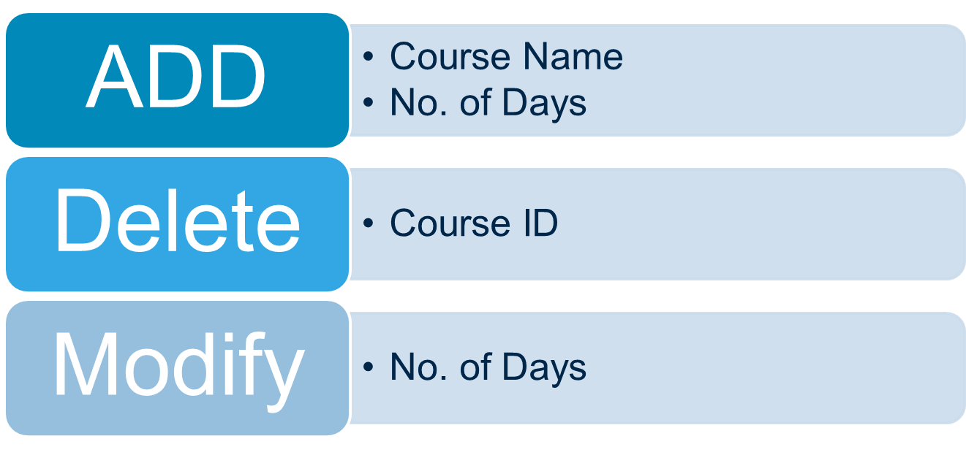
TRAINING ADMINISTRATOR MODULE
Course Maintenance:

Slide 11
TRAINING ADMINISTRATOR MODULE
Course Maintenance:
1. ADD
Add Course
2.Delete
Delete Course
3. Update
Update Course

Slide 12
TRAINING ADMINISTRATOR MODULE
Feedback Reports:
1.Average
Feedback
Displays Average Feedback
2.According to Faculty Id
Displays Feedback based on Faculty Id
3.Default Feedback
Displays Default Feedback

Slide 13
TRAINING COORDINATOR MODULES
Training Program Maintenance:
1.Add
Add Course
2.Delete
Delete Course
3.Update
Update Course
4.View
View All Courses

Slide 14
TRAINING COORDINATOR MODULE
Enrolling the participant:
Enrolling the participants to the different training programs.
  Select Training Code
  Select Participant ID

Slide 15
COORDINATOR MODULE
Feedback Reports:
1.Average Feedback
Displays Average Feedback
2.According to Faculty Id
Displays Feedback based on Faculty Id
3.Default Feedback
Displays Default Feedback

Slide 16
PARTICIPANT MODULE
Can fill feedback for the training Courses
Can view which courses are assigned
Can view the courses for which feedback has to be submitted
Provide Comments & Suggestions for training course
Rate the course according to different parameters set by Administrator from 1 to 5.

Slide 17
LEARNING
Implemented the project Feedback Management System, using Spring framework with JPA and JSP.
Team Work.
Time Management and Work Distribution.

Slide 18
BEST PRACTICES
Followed placing comments in appropriate places
Followed naming conventions.
Followed proper indentation.

Slide 19
OPPORTUNITY FOR IMPROVEMENT
The following features can be further implemented to improve the project:-
  A Super-Admin can be created which can add new employees.
  Training Admin can be provided functionality to create custom forms.

Slide 20


